Slide 1
STOCK MATE
Semester 3
Branch : -
Computer Engineering
Domain Area : -
Web Application Development
By:
Darshan (19DCE036),
Priyanshu (19DCE052),
Tanmay (19DCE021),
Yash (19DCE056).
Supervisor : -
Prof. Bhavika Patel

Slide 2
Problem statement
To make a back testing algorithm to check different trading strategies.

Slide 3
General Hypothesis
To trade or invest in a company, certain people use different trading strategies.
First, we have to download the accurate data into excel sheets.
Then after that we have to make formula applicable in excel for indicators used in strategies.
But still we can’t use excel to back-test strategies.

Slide 4
Limitations
Problems with this process: -
It is a very long process.
Finding accurate data is much harder as we’ve experienced such problem.
Making formulas in excel isn’t easy, for complex algorithms(formulas) of indicators.
To even find correct formulas for indicators & back testing algorithm is a challenge.
We will have to update data again & again after each day because stock-market changes everyday.

Slide 5
Proposed Hypothesis
Our website will overcome all the previously stated problems because it will directly take data from internet as per the date entered.
Algorithms will be programmed & will be more efficient than in excel.
It will be much faster comparatively.

Slide 6
Scope of the System
Functionalities : -
Back-testing of strategies with varieties of indicators.
Back-testing for all the stocks & any time period.
Account based system for usage of above functionality.

Slide 7
Consolidated List of Requirements
Python.
Django, pandas.
PyCharm.
Text editors – vs, atom, sublime text, etc.
Html, CSS, JS, Bootstrap.
A laptop/pc to be able to execute all these things.

Slide 8
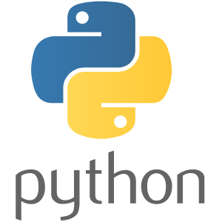
Software Requirements
Python – to code the complex algorithms.

Slide 9


Python Libraries
Django – as a framework to integrate our python code into html easily.
Pandas – to fetch data from the internet.

Slide 10

Software Requirements
Contd..
PyCharm – to easily compile, run & organize python code.

Slide 11

Software Requirements
Contd..
GitHub – to be easily able to contribute to the code by team members & to organize our code as we make progress.

Slide 12




Software Requirements
Contd..
Text editors – to easily manage different files at once while working with different files altogether.

Slide 13
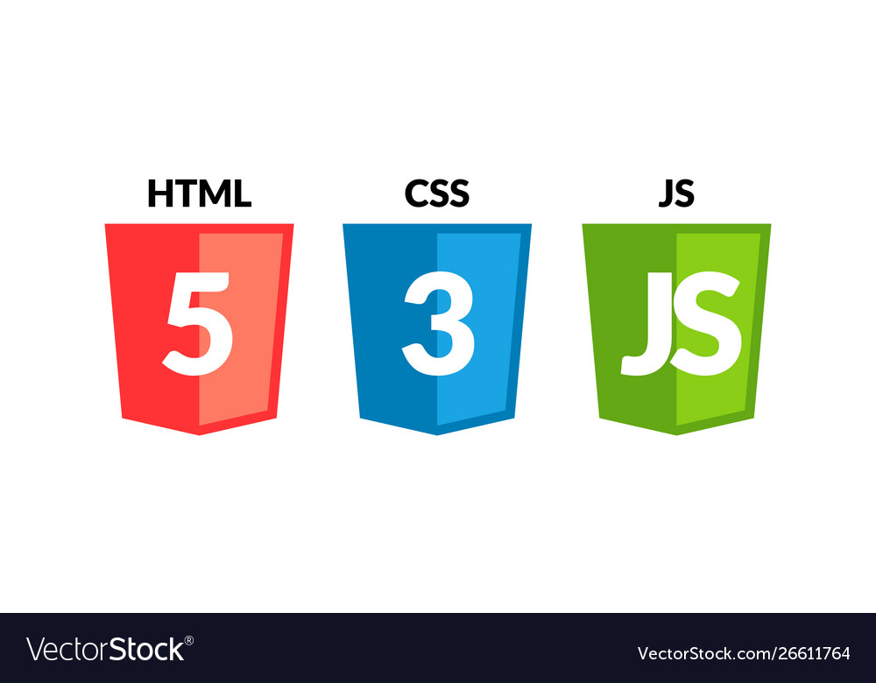

Software Requirements
Contd..
For front end:- to make A series of webpages with distinct design.

Slide 14
Project Planning
Jul 10 - Jul 20
Stock Market
Jul 20 - Jul 30
Back-Testing & Indicators
Learning
Aug 3 - Aug 10
Python
Aug 15 - Aug 30
Django
Sep 1 - Sep 5
Front-End Technologies
Sep 6 - Sep 11
Creating Indicators
Back-End
Sep 16 - Sep 30
Creating Backtesting Algorithm
12 days
Oct 1 - Oct 17
Django
Oct 17 - Oct 25
HTML/CSS/JS/Bootstrap
Front-End
100%
Oct 26 - Oct 28
Polishing
2020
Jul
Aug
Sep
Oct
2020
Today

Slide 15
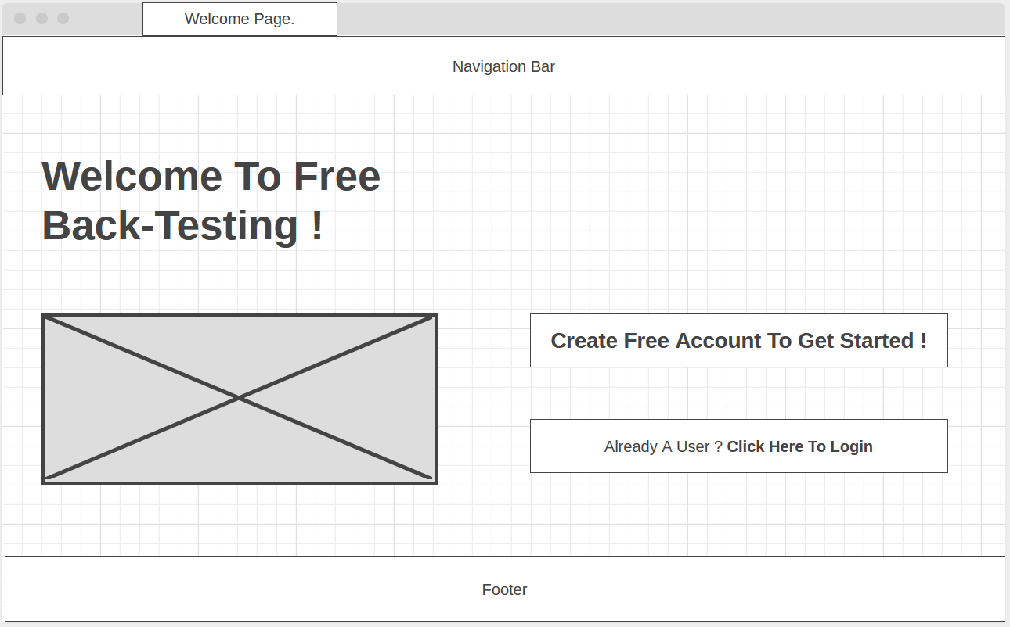
Prototypes For Front-End

Slide 16
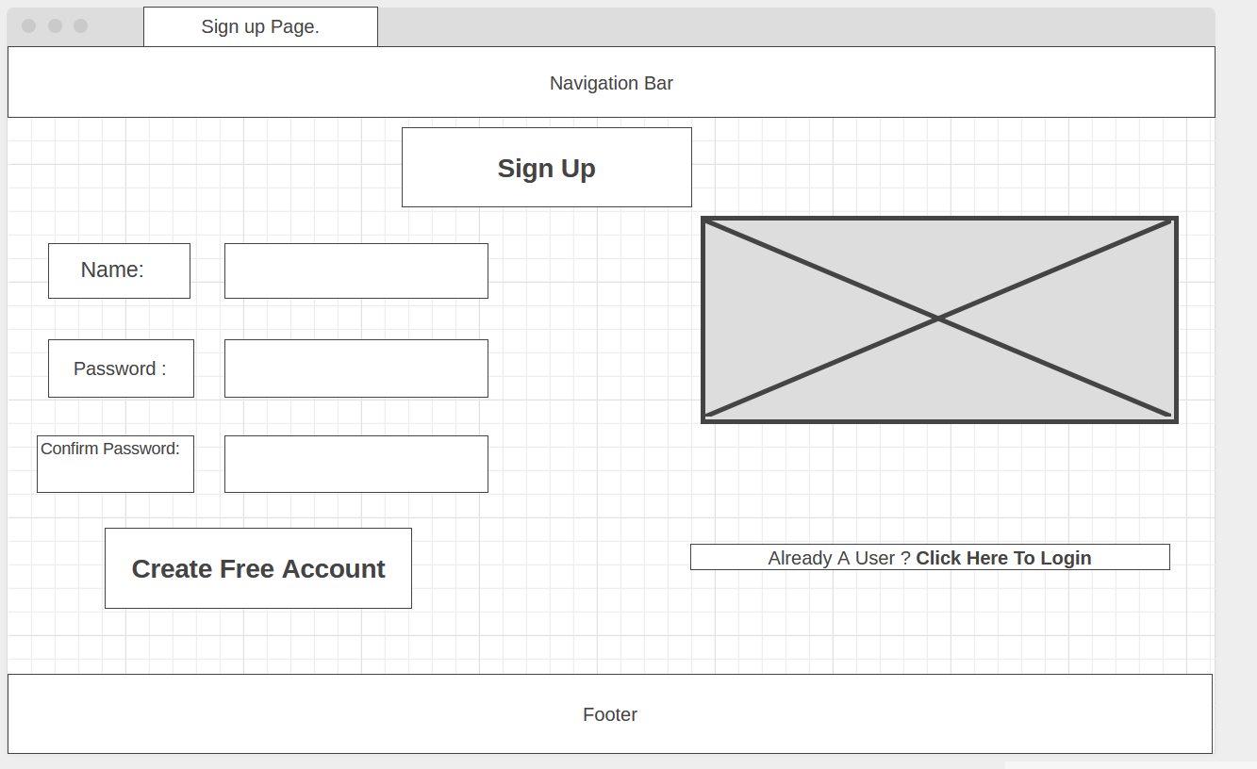
Prototypes For Front-End
Contd..

Slide 17
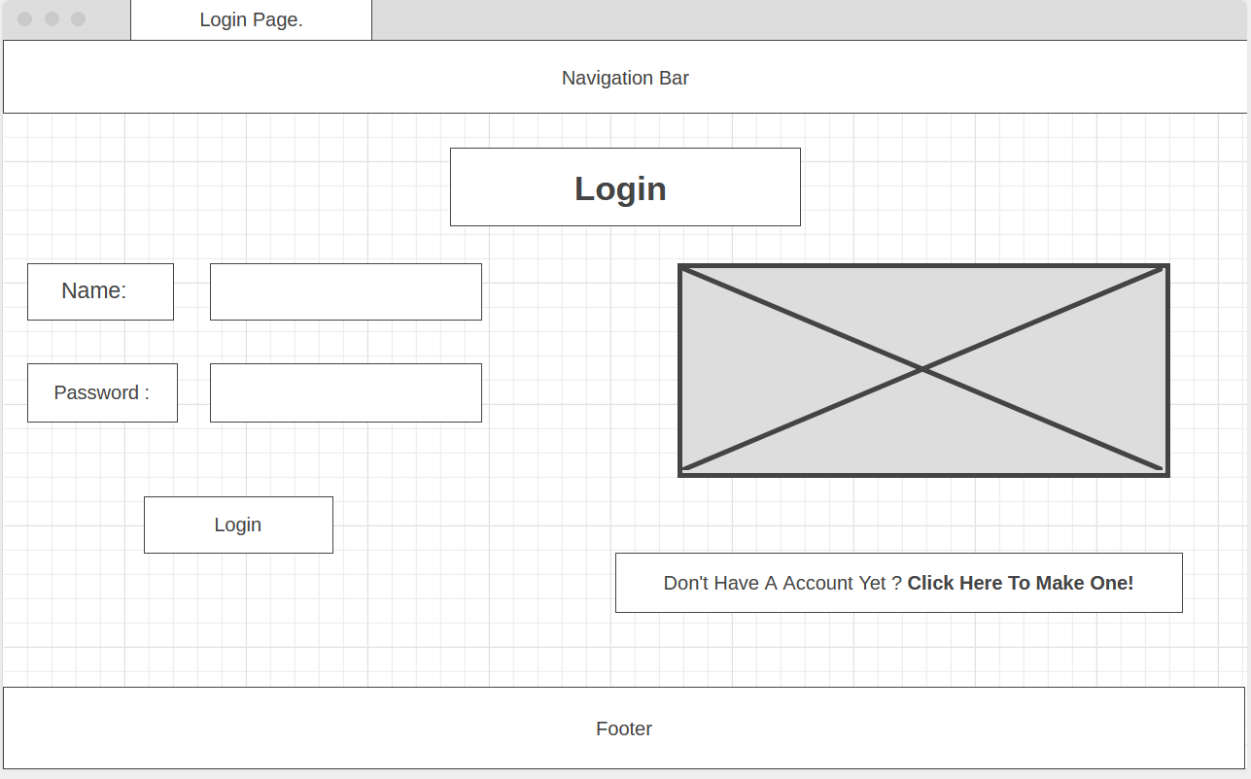
Prototypes For Front-End
Contd..

Slide 18
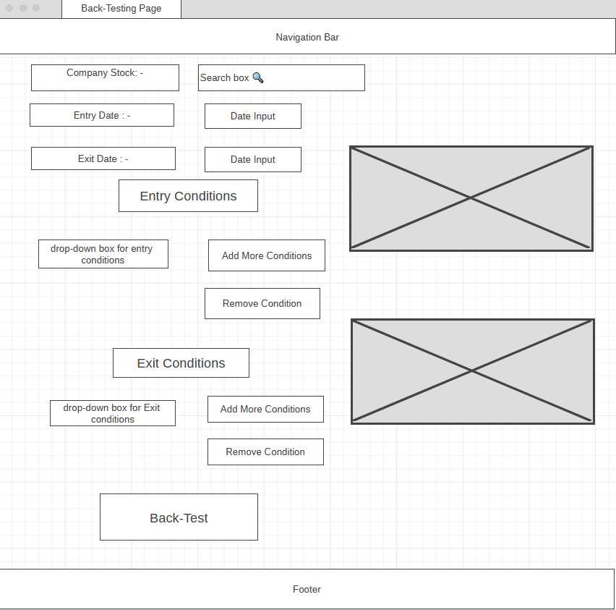
Prototypes For Front-End
Contd..

Slide 19
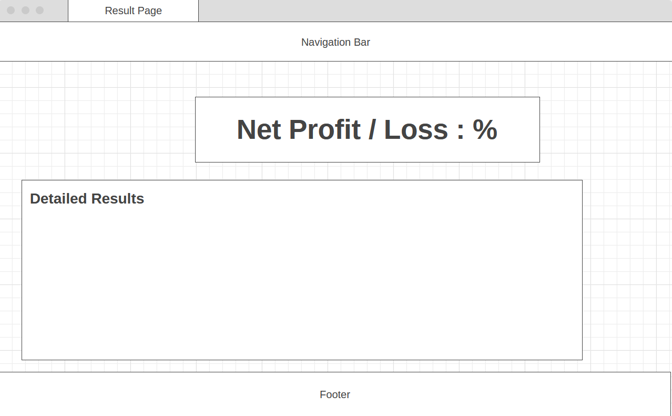
Prototypes For Front-End
Contd..

Slide 20
Implementation Details
As we spent almost 2 months for learning of our project, the coding part will be a bit easier.
Coding indicators will be done by all.
Priyanshu will code the back testing algorithm.
Tanmay will integrate that code to html & make a basic set of webpages.
Darshan & Yash will use Html, CSS, JS & bootstrap to design our website into our desired stage.

Slide 21
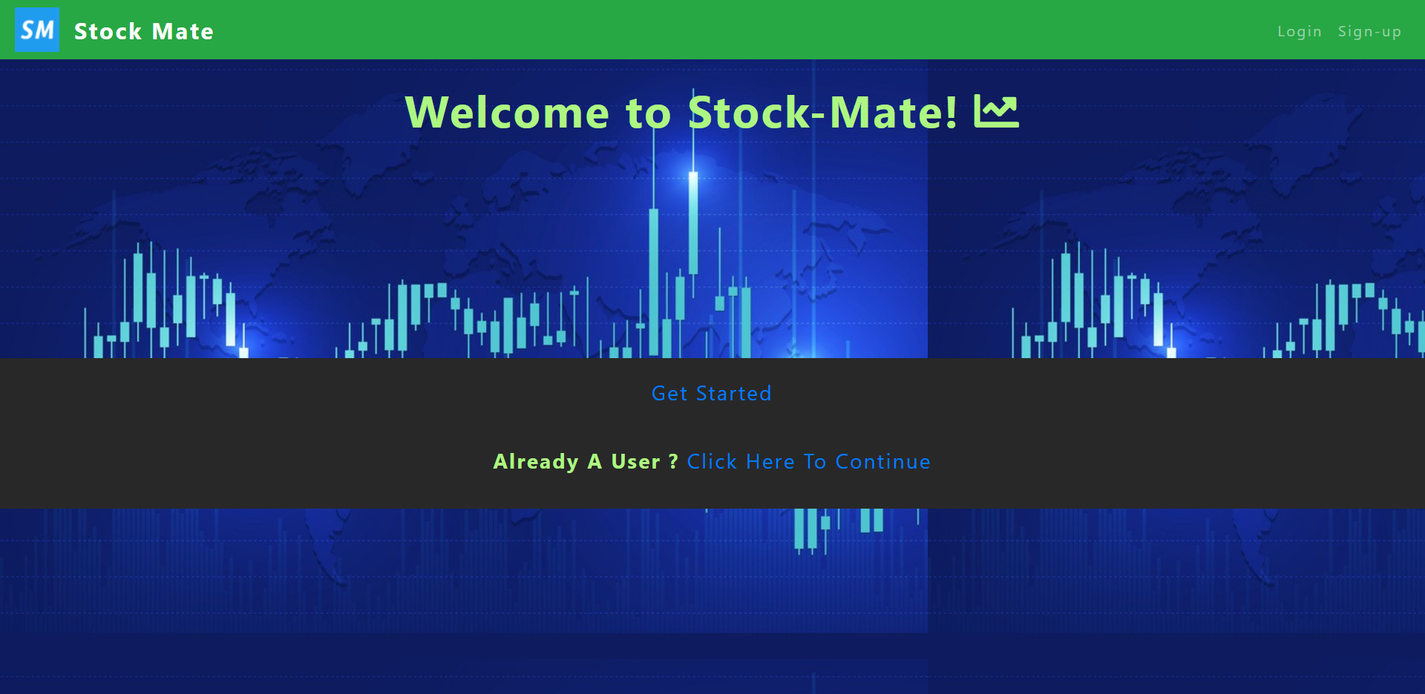
Snap Shots.

Slide 22
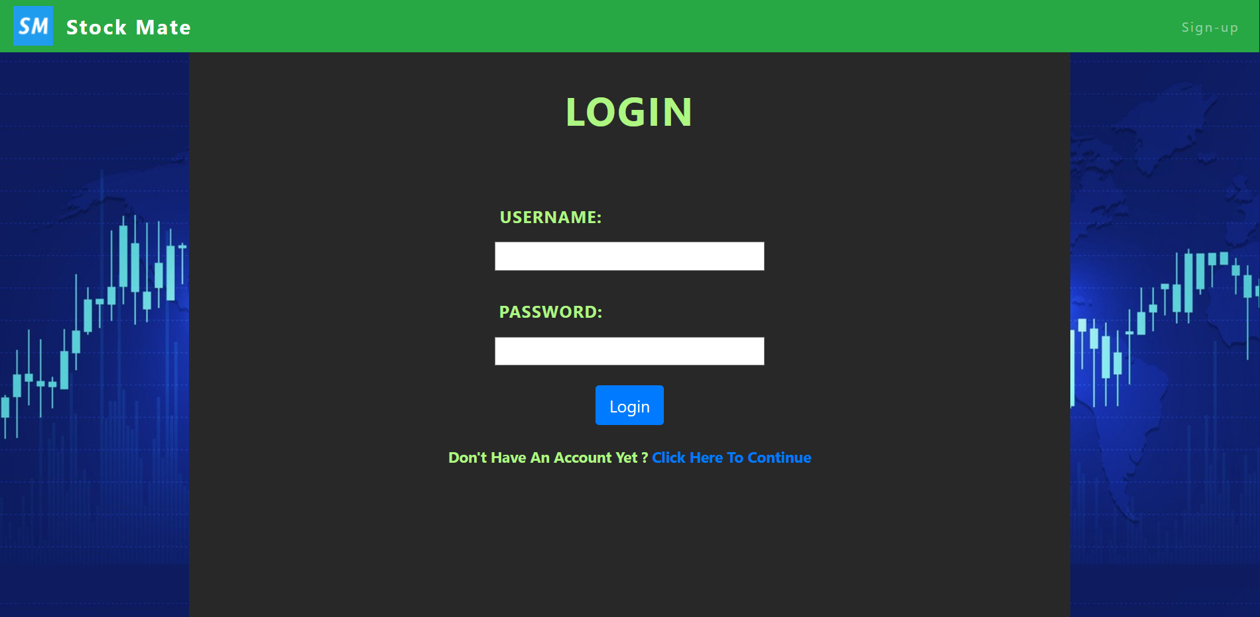
Snap Shots.
Contd..

Slide 23
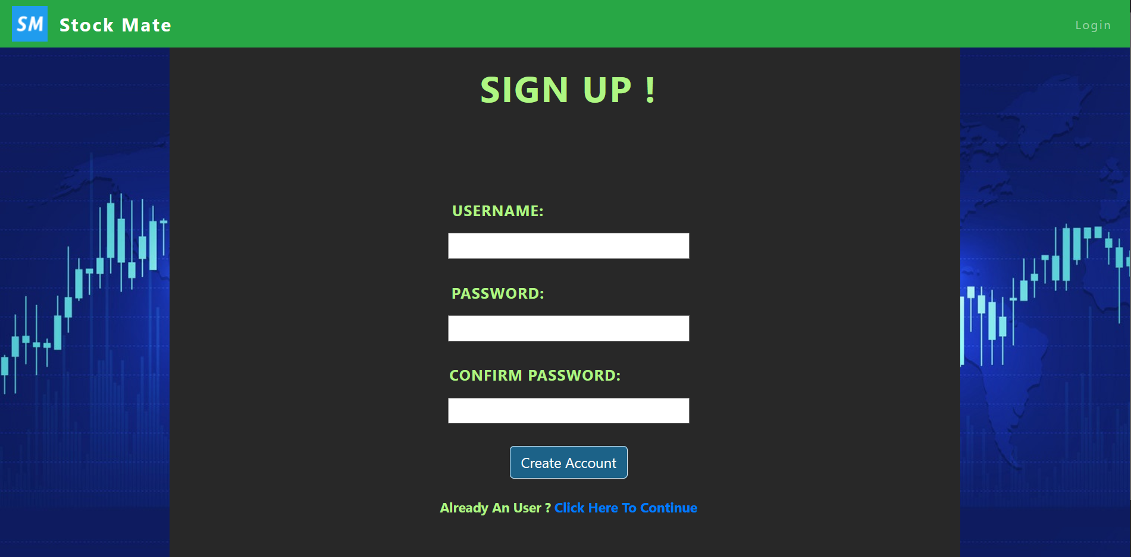
Snap Shots.
Contd..

Slide 24
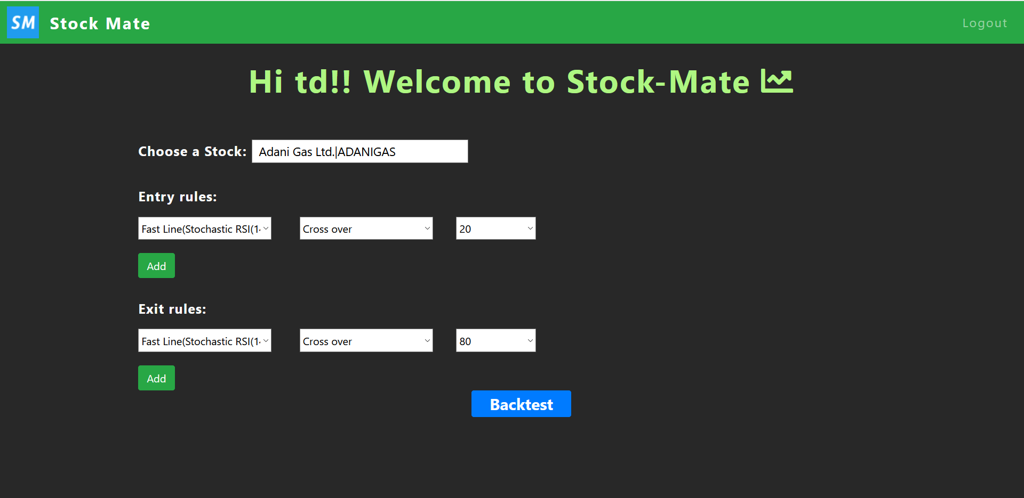
Snap Shots.
Contd..

Slide 25
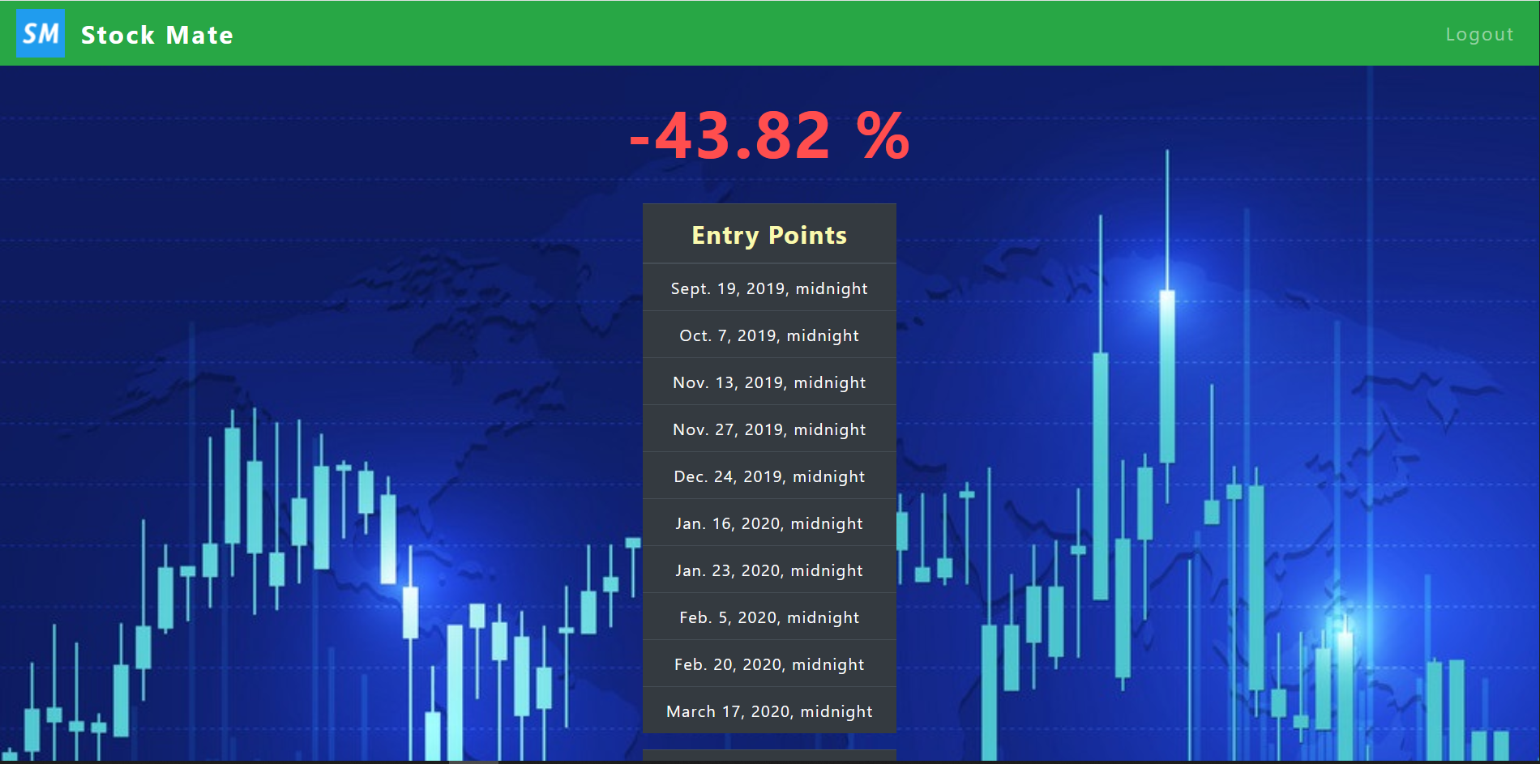
Snap Shots.
Contd..

Slide 26
Demonstration
Let’s See the demo.

Slide 27
Limitations
Our website just back-tests strategies over past data, there’s no way of knowing if the user’s strategy works.
Our website don’t work for complex strategies.
It has limited number of back-testing algorithms for only famous indicators which are used by all.

Slide 28
Future Scope
Using AI/ML & Data Science In our project we can improve our project in a way that it predicts that the strategy will work or fail.
Also we can make a design a near-to-perfect strategy which will work in almost all the stocks.
We can add other indicators & their back-testing algorithms.

Slide 29
Conclusion
We made a fully responsive website for back-testing of strategies with multiple indicators at a time.

Slide 30
Project Outcomes
Team-work.
Knowing how to manage while working with a team.
Situational leadership.
New Technologies like : Python, Django, HTML, CSS, JS, Pandas Library of Python ,etc.

Slide 31
References
Yahoo for fetching data of different stocks/companies.
Trading view- https://in.Tradingview.Com/chart/- as a reference to check our algorithms for indicators & also to few formulas for indicators.
Investopedia - https://www.Investopedia.Com/ &
stock charts - https://stockcharts.Com/ for formulas of different indicators.
Wireframing - https://wireframe.Cc/ for making website’s wireframe(sketch).

Slide 32
Thank You !

